Slide 1
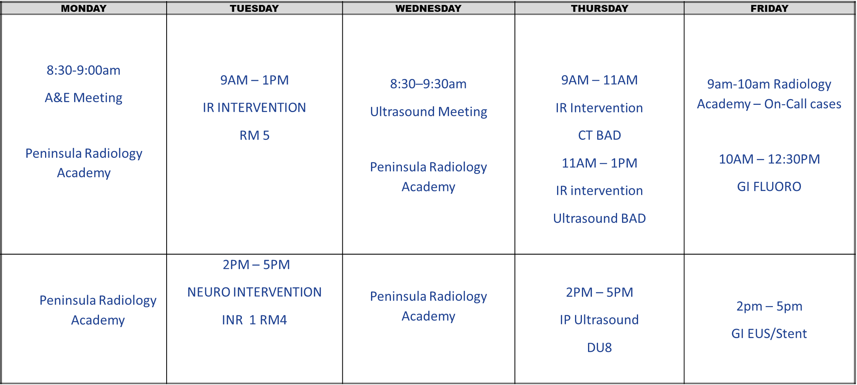
South West Imaging Training Academy
Radiology Taster session Rota

